Slide 1
Let’s discuss a New Richland park & new Hadley park branch library
Results from Community Meetings and On-Line Surveys

Slide 2
Planning funding for new Richland park & Hadley park branch libraries
Funding for a potential new Richland Park Library was approved in FY 2018-2019 – in our NPL Facilities Master Plan, a new Richland Park Branch Library is slated to be built in FY 2019-2020. This is NPL’s next branch and top priority.
Funding for a potential new Hadley Park Branch Library was approved in FY 2017-2018 – in our NPL Facilities Master Plan, a new Hadley Park Branch Library is slated to be built in FY 2020-2021.

Slide 3
What are the first steps for building a new facility?
First step is to have the budget for building a new facility along with the anticipated year in which a new facility would be built entered in Metro’s CIB (Capital Improvement Budget). Any capital project must be in this budget that is approved by Metro Council to be considered for funding
Once a department has money for planning the new facility the department must make steps to:
Study where the building might go
Determine how large of a facility is needed
Decide what will be happening in each area/space and how much square footage is needed for each space (Programming)
Decide how will the areas/spaces interact with other areas/spaces (Adjacencies)

Slide 4
How does npl get input for wanted and needed programming and adjacencies in a new facility?
NPL has a contract with an architecture firm that specializes in library design. Maureen Arndt with 720 Design is the NPL’s consultant to facilitate Community Meetings to gather the information NPL needs to make design and size decisions for all new and major renovated facilities.
720 Design holds Community Meetings with the public, staff and stakeholders.
Community Meetings were held for each community:
Richland Park – Between February 4th and February 5th. NPL held 7 community, staff and stakeholder meetings. Number in attendance over the 2 day period was 243.
Hadley Park – Between February 25 and February 26th. NPL held 5 community, staff and stakeholder meetings. Number in attendance over the 2 day period was 48.

Slide 5
Gathering information: richland Park
Questions asked at each meeting:
Do you or members of your family use the library?
From your perspective, what are the most significant changes taking place in your community?
What pressing needs in your community might the library help address?
How does the library fit into your future vision of the community?
What is your favorite library in Nashville or anywhere? Why?
What do we need to include in our planning process to ensure we include the unique nature of the community?

Slide 6
Next Step: Possibilities
720 Design presented a slide show of what we can put into a new library space.
After the presentation, each person attending was given 10 stickers - 5 green stickers and 5 red stickers.
Each person was asked to put the stickers on a paper version of the presentation and to use all of their stickers. Green for items they were either drawn to or felt they just had to have in the new facility. Red for the items they felt would not fit or absolutely did not want.

Slide 15
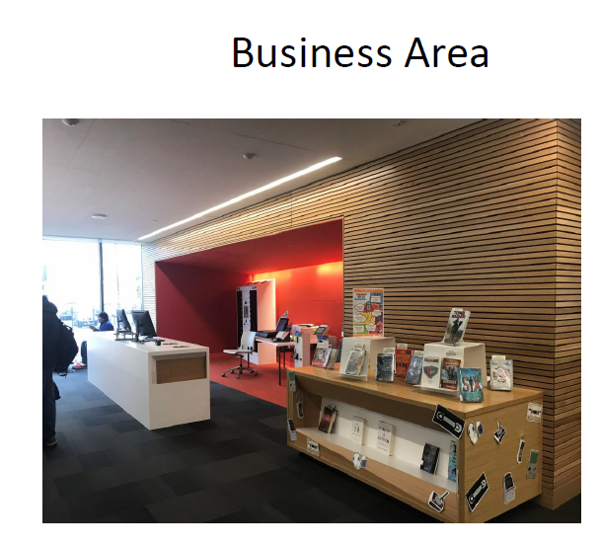

Slide 19
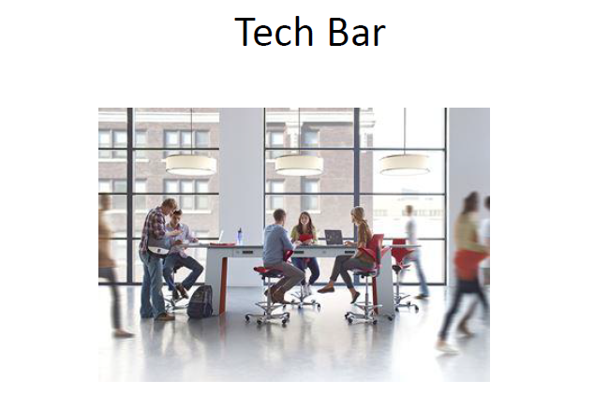

Slide 21
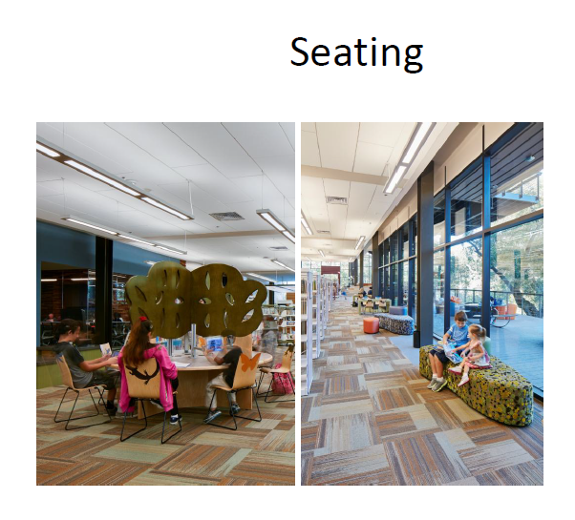

Slide 28
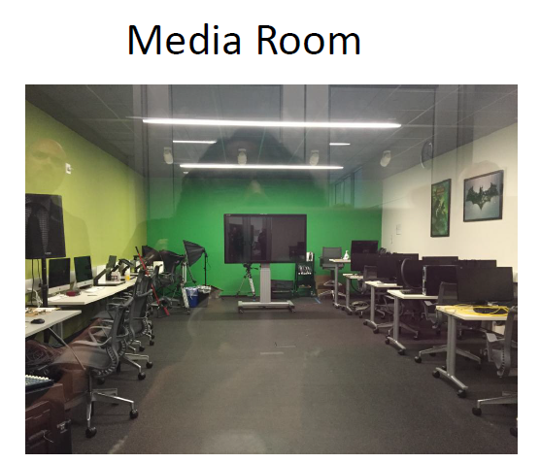

Slide 29
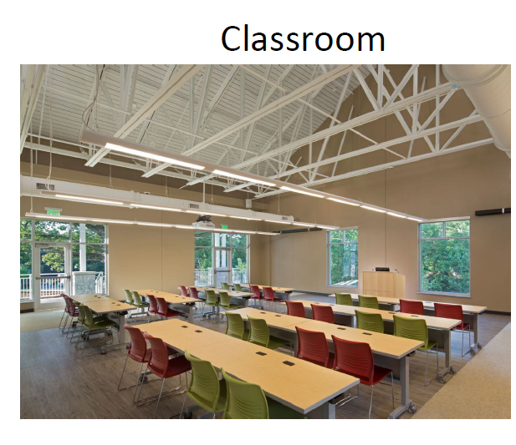

Slide 30
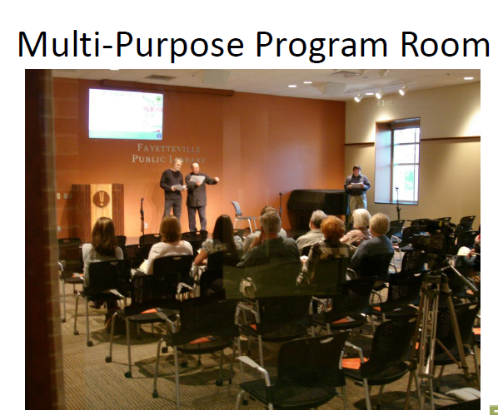

Slide 32
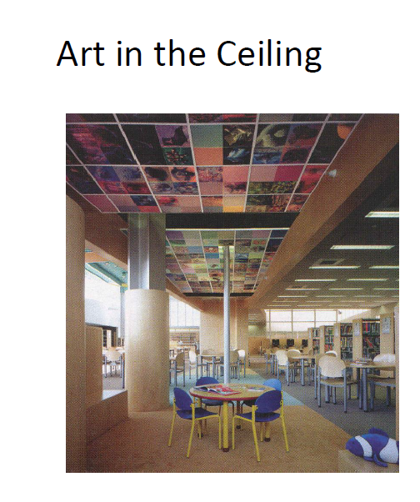

Slide 35
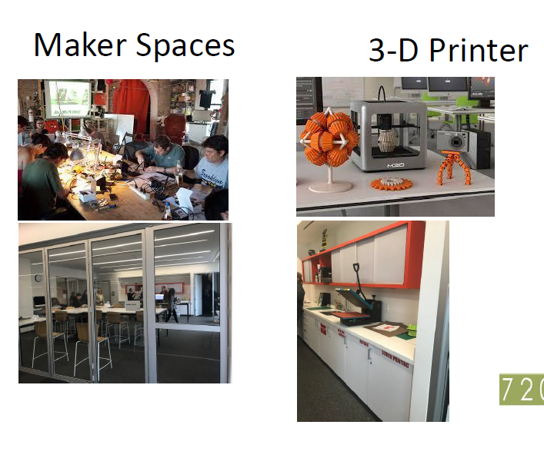

Slide 37
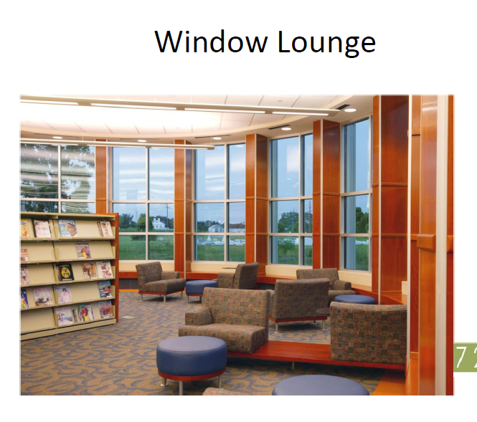

Slide 38
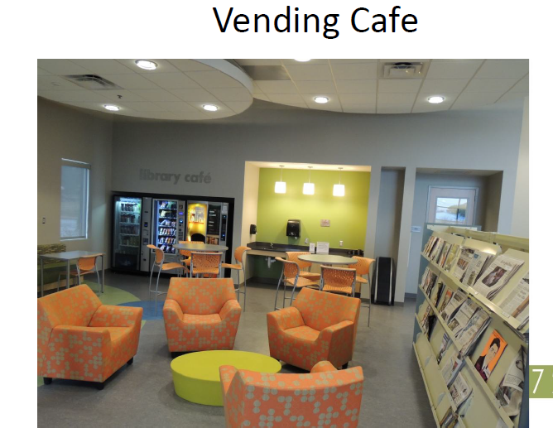

Slide 40
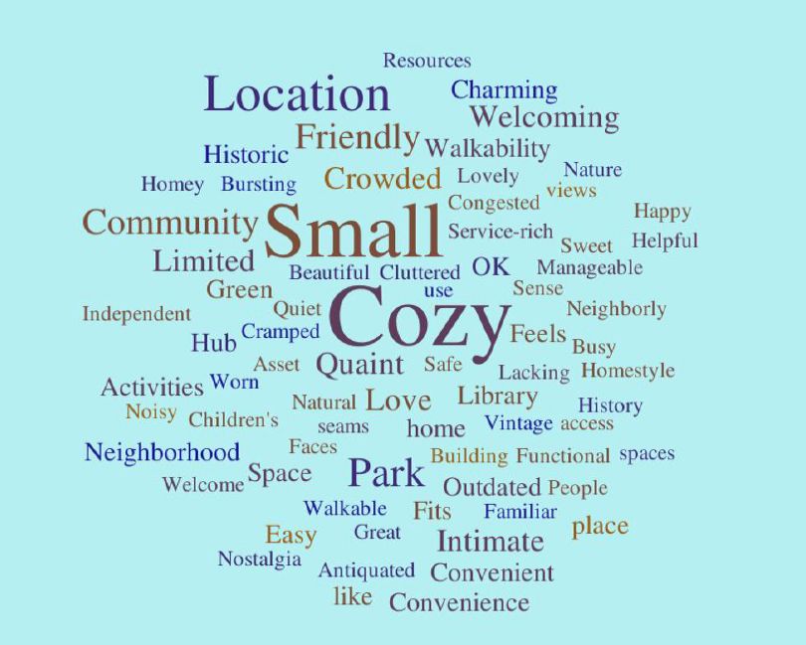

Slide 41
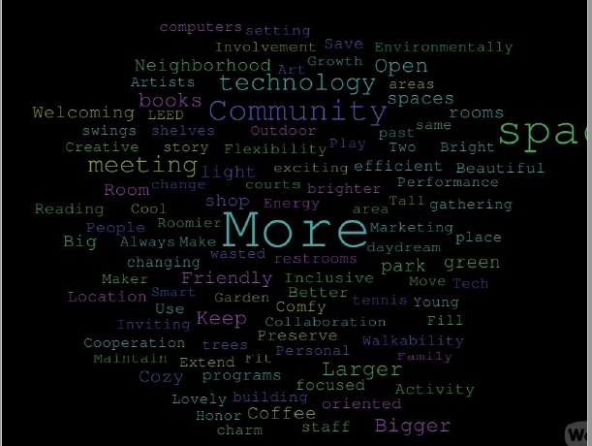

Slide 42
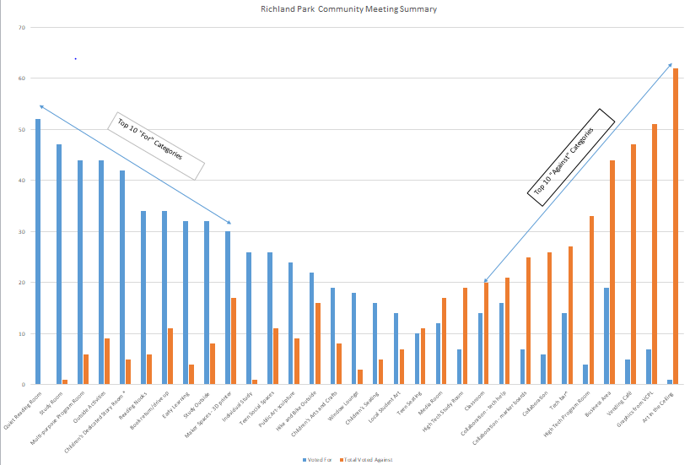

Slide 43
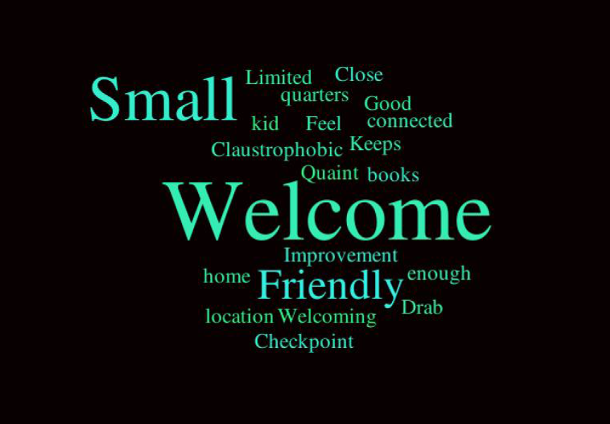

Slide 44
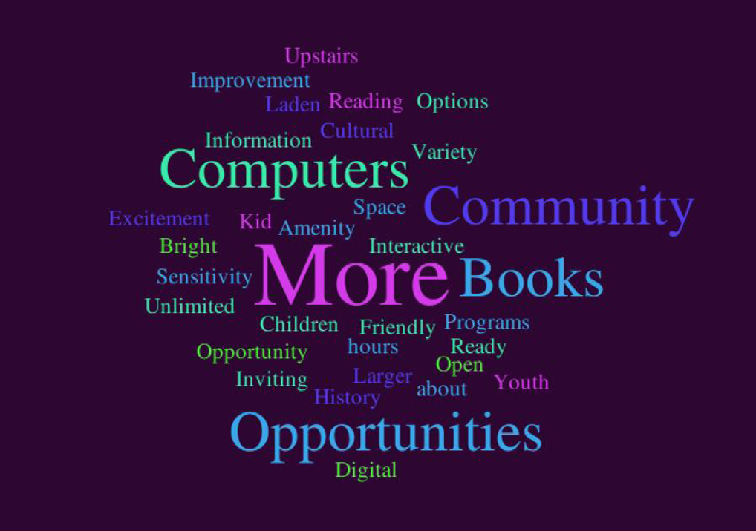

Slide 45
